Slide 1
Don’t get carried away with the CCA: Trust Modifications after CCA 202352018
October 29, 2024
Beth Shapiro Kaufman
Daniel R. Stanek
Partner, Lowenstein Sandler LLP Chair, Private Client Services
Bessemer Trust Company of Delaware, N.A. Fiduciary Counsel

Slide 2
CCA 202352018
CCA 202352018 considers a situation in which a tax reimbursement clause is added to an existing grantor trust by means of a judicial modification with the consent of all beneficiaries.
It concludes that adding a tax reimbursement clause will constitute a taxable gift by the trust beneficiaries because the addition of a discretionary power to distribute income and principal to the grantor is a relinquishment of a portion of the beneficiaries’ interests in the trust.

Slide 3
Distinguishing Rev. rul. 2004-64
Continuum:
Original trust provides for reimbursement of grantor’s income tax on trust’s income.
State law provides a reimbursement right for grantor’s income tax on trust’s income
State law enacted after trust created provides a reimbursement right
Trust modified to include a reimbursement right
CCA: “This is distinguishable from the situations in Rev. Rul. 2004-64 where the original governing instrument provided for a mandatory or discretionary right to reimbursement for the grantor’s payment of the income tax.”

Slide 4
CONSENT vs. failure to object
Facts in CCA state that the beneficiaries consented to the trust modification.
But CCA goes on to state: “The result would be the same if the modification was pursuant to a state statute that provides beneficiaries with a right to notice and a right to object to the modification and a beneficiary fails to exercise their right to object.”

Slide 5
Valuation of gift
CCA concludes:
“As a result of the Year 2 modification, Child and Child’s issue each have made a gift of a portion of their respective interest in income and/or principal.”
Footnote No. 2: “Although the determination of the values of the gifts requires complex calculations, Child and Child’s issue cannot escape gift tax on the basis that the value of the gift is difficult to calculate.” Citing Smith v. Shaughnessy, 318 U.S. 176, 180 (1943).

Slide 6
What is a CCA?
Chief Counsel Advice:
Reflects the IRS’s litigating position in a real case
Does not reflect any input from the taxpayer
Would be a private document but for FOIA
Is an advocacy piece
Is not entitled to deference in court

Slide 7
Treas. reg. §25.2511-1(g)(1)
Donative intent on the part of the transferor is not an essential element in the application of the gift tax to the transfer. The application of the tax is based on the objective facts of the transfer and the circumstances under which it is made, rather than on the subjective motives of the donor. However, there are certain types of transfers to which the tax is not applicable. It is applicable only to a transfer of a beneficial interest in property. It is not applicable to a transfer of bare legal title to a trustee. A transfer by a trustee of trust property in which he has no beneficial interest does not constitute a gift by the trustee (but such a transfer may constitute a gift by the creator of the trust, if until the transfer he had the power to change the beneficiaries by amending or revoking the trust). The gift tax is not applicable to a transfer for a full and adequate consideration in money or money's worth, or to ordinary business transactions, described in §25.2512-8.
Perhaps agreeing to reimbursement of taxes is not a gratuitous transfer.
Grantor could renounce grantor trust powers.

Slide 8
Treas. reg. §25.2511-1(g)(2)
What if trustee/beneficiary is constrained by an ascertainable standard.
Support in Treas. Reg. § 25.2511-1(g)(2) :
If a trustee has a beneficial interest in trust property, a transfer of the property by the trustee is not a taxable transfer if it is made pursuant to a fiduciary power the exercise or nonexercise of which is limited by a reasonably fixed or ascertainable standard which is set forth in the trust instrument....
CCA seems to argue that trustee/beneficiary has a duty to fight against distributions to others.

Slide 9
Contrary Authority
DiMarco v. Commissioner (1986)
Rev. Rul. 67-370
PLR 201122007

Slide 10
Delaware trust law to the rescue
Merger
Decanting
Non-Judicial Settlement Agreement
Modification by Grantor
Role of Designated Representative
Role of Virtual Representation

Slide 11
Merger - 12 Del. C. § 3525(29)
§ 3325. Specific powers of trustee [For application of this section, see 79 Del. Laws, c. 172, § 6; 80 Del. Laws, c. 153, § 5].
Without limiting the authority conferred by § 3324 of this title, a trustee may:
…
(29) Declare 1 or more new trusts for the purpose of merging all, or a portion, of the trust with or into the new trust or trusts and merge all or a portion of the trust with or into any other trust or trusts, including statutory trusts and foreign statutory trusts as defined in § 3801 of this title, whether or not created by the same trustor and whether or not funded prior to the merger, to be held and administered as a single trust if such a merger would not result in a material change in the dispositive terms of the trust defining the nature and extent of any trust beneficiary’s interest in the principal or income of the trust;

Slide 12
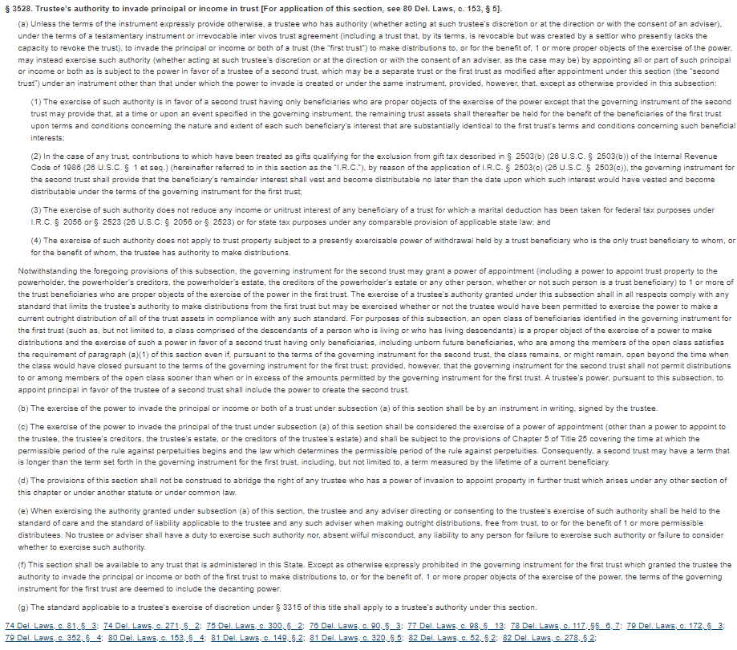
Decanting - 12 Del. C. § 3528

Slide 13
Decanting - 12 Del. C. § 3528
“…a trustee who has authority… to invade the principal or income or both of a trust (the “first trust”) to make distributions to, or for the benefit of, 1 or more proper objects of the exercise of the power, may instead exercise such authority… by appointing all or part of such principal or income or both as is subject to the power in favor of a trustee of a second trust, which may be a separate trust or the first trust as modified after appointment under this section (the “second trust”)… provided, however, that, except as otherwise provided in this subsection:
The exercise of such authority is in favor of a second trust having only beneficiaries who are proper objects of the exercise…

Slide 14
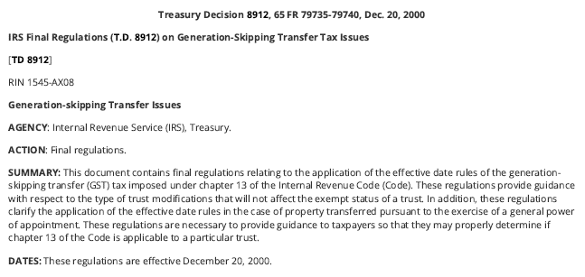
Treasury Decision 8912, 65 FR 79735-79740, Dec. 20, 2020

Slide 15
Treasury Decision 8912, 65 FR 79735-79740, Dec. 20, 2020
Under the proposed regulations, where there is a distribution of trust principal from an exempt trust to a new trust, the new trust will be an exempt trust if the terms of the governing instrument of the old trust authorize the trustee to make distributions to the new trust without the consent or approval of any beneficiary or court and the terms of the new trust do not extend the time for vesting of any beneficial interest in the trust beyond the applicable perpetuities period. . . .
One comment suggested that the final regulations provide that a discretionary distribution that otherwise satisfies the regulatory requirements should not cause the trust to lose exempt status if the trustee, although not required to do so, seeks approval of a court or the trust beneficiaries before taking action. This change was deemed unnecessary. An action that satisfies the requirements of the regulations will not cause loss of exempt status even if, for whatever reason, the trustee seeks a court's or a beneficiary's approval of such action.

Slide 16
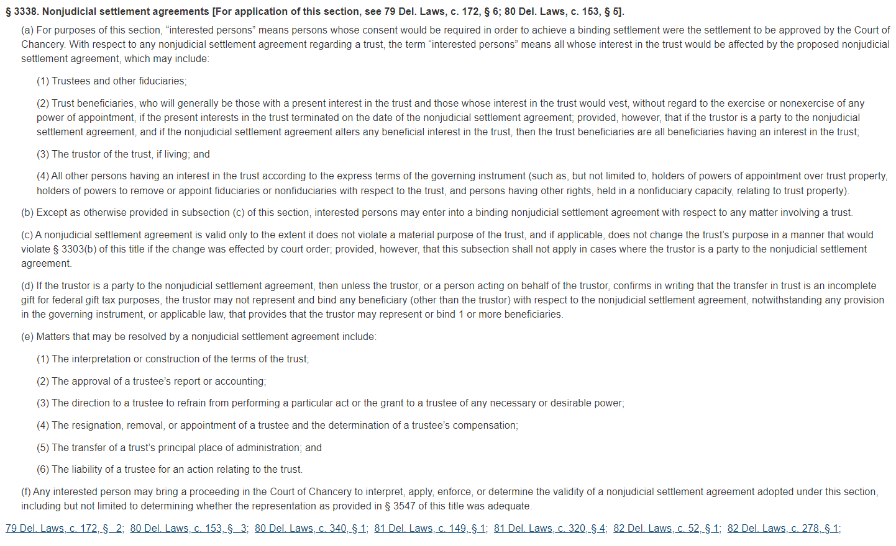
NJSA - 12 Del. C. § 3338

Slide 17
NJSA - 12 Del. C. § 3338
(b) Except as otherwise provided in subsection (c) of this section, interested persons may enter into a binding nonjudicial settlement agreement with respect to any matter involving a trust.

Slide 18
NJSA - 12 Del. C. § 3338
(a) For purposes of this section, “interested persons” means persons whose consent would be required in order to achieve a binding settlement were the settlement to be approved by the Court of Chancery. With respect to any nonjudicial settlement agreement regarding a trust, the term “interested persons” means all whose interest in the trust would be affected by the proposed nonjudicial settlement agreement, which may include:
(1) Trustees and other fiduciaries;
(2) Trust beneficiaries, who will generally be those with a present interest in the trust and those whose interest in the trust would vest, without regard to the exercise or nonexercise of any power of appointment, if the present interests in the trust terminated on the date of the nonjudicial settlement agreement; provided, however, that if the trustor is a party to the nonjudicial settlement agreement, and if the nonjudicial settlement agreement alters any beneficial interest in the trust, then the trust beneficiaries are all beneficiaries having an interest in the trust;
(3) The trustor of the trust, if living; and
(4) All other persons having an interest in the trust according to the express terms of the governing instrument (such as, but not limited to, holders of powers of appointment over trust property, holders of powers to remove or appoint fiduciaries or nonfiduciaries with respect to the trust, and persons having other rights, held in a nonfiduciary capacity, relating to trust property).

Slide 19
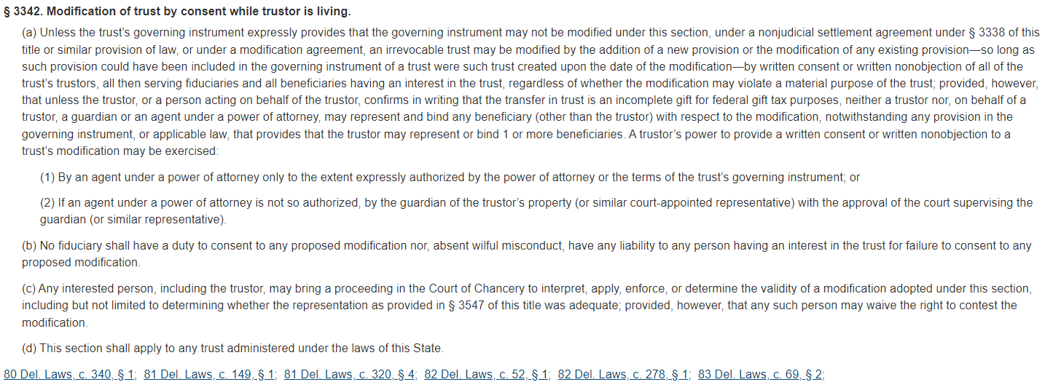
Grantor modification - 12 Del. C. § 3342

Slide 20
Grantor modification - 12 Del. C. § 3342
…an irrevocable trust may be modified by the addition of a new provision or the modification of any existing provision—so long as such provision could have been included in the governing instrument of a trust were such trust created upon the date of the modification—by written consent or written nonobjection of all of the trust’s trustors, all then serving fiduciaries and all beneficiaries having an interest in the trust, regardless of whether the modification may violate a material purpose of the trust…

Slide 21
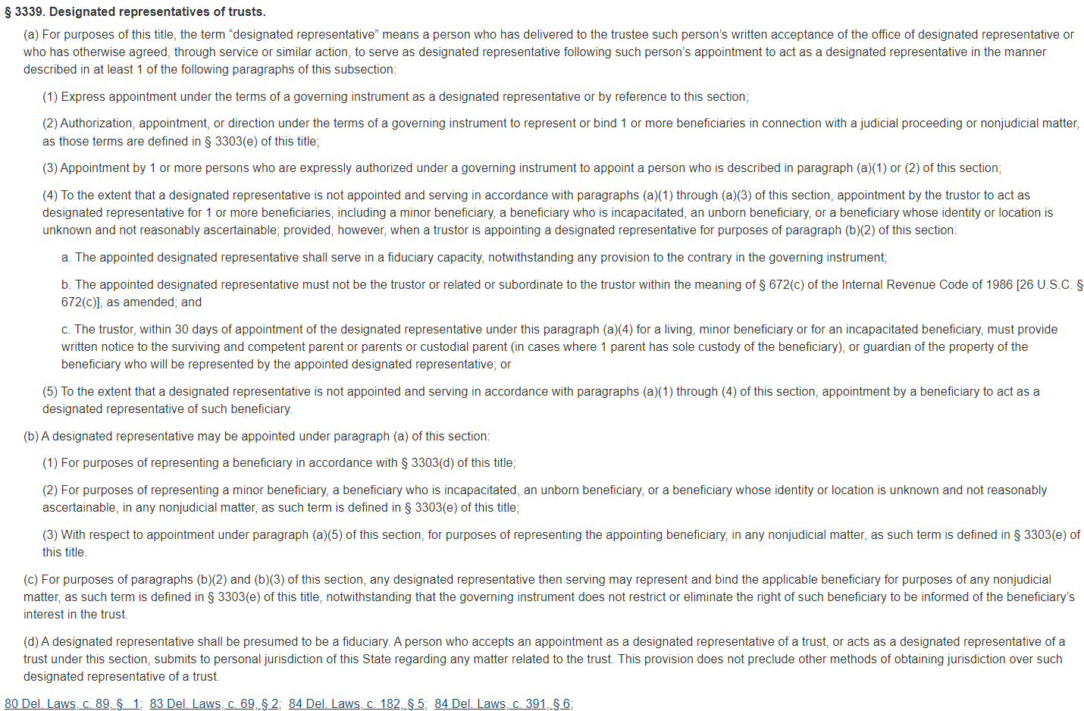
Designated Representative - 12 Del. C. § 3339

Slide 22
Designated Representative - 12 Del. C. § 3339
(a) For purposes of this title, the term “designated representative” means a person who has delivered to the trustee such person’s written acceptance of the office of designated representative or who has otherwise agreed, through service or similar action, to serve as designated representative following such person’s appointment to act as a designated representative in the manner described in at least 1 of the following paragraphs of this subsection:
(1) Express appointment under the terms of a governing instrument as a designated representative or by reference to this section;
(d) A designated representative shall be presumed to be a fiduciary…

Slide 23
Designated Representative - 12 Del. C. § 3339
(4) To the extent that a designated representative is not appointed and serving in accordance with paragraphs (a)(1) through (a)(3) of this section, appointment by the trustor to act as designated representative for 1 or more beneficiaries, including a minor beneficiary, a beneficiary who is incapacitated, an unborn beneficiary, or a beneficiary whose identity or location is unknown and not reasonably ascertainable; provided, however, when a trustor is appointing a designated representative for purposes of paragraph (b)(2) of this section:
a. The appointed designated representative shall serve in a fiduciary capacity, notwithstanding any provision to the contrary in the governing instrument;
b. The appointed designated representative must not be the trustor or related or subordinate to the trustor within the meaning of § 672(c) of the Internal Revenue Code of 1986 [26 U.S.C. § 672(c)], as amended; and
c. The trustor, within 30 days of appointment of the designated representative under this paragraph (a)(4) for a living, minor beneficiary or for an incapacitated beneficiary, must provide written notice to the surviving and competent parent or parents or custodial parent (in cases where 1 parent has sole custody of the beneficiary), or guardian of the property of the beneficiary who will be represented by the appointed designated representative; or
(5) To the extent that a designated representative is not appointed and serving in accordance with paragraphs (a)(1) through (4) of this section, appointment by a beneficiary to act as a designated representative of such beneficiary.

Slide 24
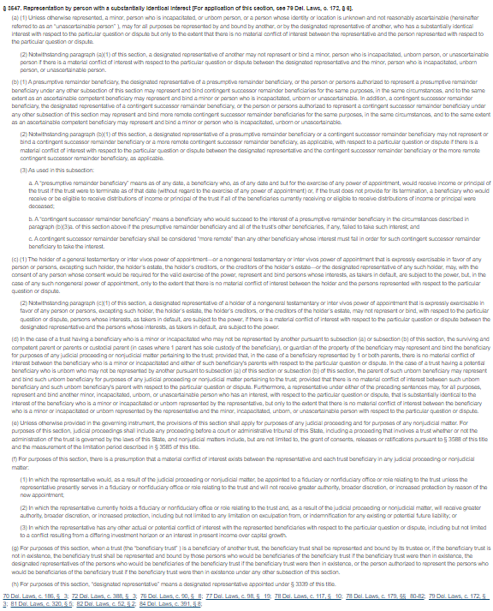
Virtual representation - 12 Del. C. § 3547

Slide 25
Virtual representation - 12 Del. C. § 3547
(a)(1) Unless otherwise represented… a person… may for all purposes be represented by and bound by another… who has a substantially identical interest with respect to the particular question or dispute but only to the extent that there is no material conflict of interest between the representative and the person represented with respect to the particular question or dispute…

Slide 26
Virtual representation - 12 Del. C. § 3547
(a)(1) Unless otherwise represented… a person… may for all purposes be represented by and bound by another, or by the designated representative of another, who has a substantially identical interest with respect to the particular question or dispute but only to the extent that there is no material conflict of interest between the representative and the person represented with respect to the particular question or dispute.
(a)(2) Notwithstanding paragraph (a)(1) of this section, a designated representative of another may not represent or bind a… person if there is a material conflict of interest with respect to the particular question or dispute between the designated representative and the… [represented] person.

Slide 27
Questions?

